Slide 1


Digital System Design Course
Javier Felipe Pérez Olaya
Solución Parcial NOV 17 de 2009
Ph. D. Jaime Velasco - Medina

Slide 2

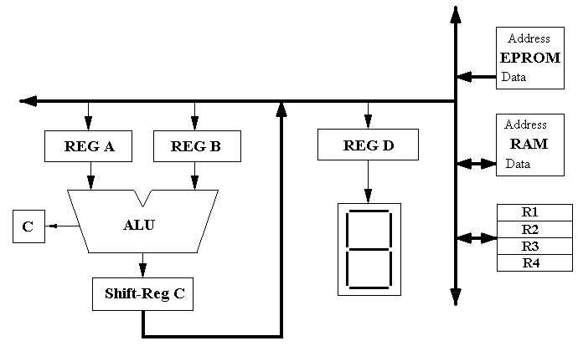
Diseñar una FSM para calcular la división N/N usando el procesador de la figura 1. Los datos son de 8 bits: Dividendo en MRAM[02], divisor en MRAM[03], cociente en R3 y residuo en R4. Realizar ASM y RTL con señales de control.
Figura 1. Procesador para implementar División N/N Y Logaritmo
Ph. D. Jaime Velasco – Medina
Digital System Design

Slide 3
Datapath especifico de la división N/N
ASM
S0
IDLE
d
0
START
S1
1
ALU
C
d← divisor
A← Dividendo
Q ← 0
cnt ←1
A
Q
0
1
dMSB
Ph. D. Jaime Velasco – Medina
Digital System Design

Slide 4
ASM
Ph. D. Jaime Velasco – Medina
Digital System Design
S2
0
1
dMSB
S3
d← shl (d,0)
A← A - d
S4
cnt ←cnt +1
1
0
AMSB
S6
S5
A← A + d
AQ← shl (AQ,1)
AQ← shl (AQ,0)
cnt ←cnt -1
cnt ←cnt -1
S7
SI
NO
IDLE
cnt = 0
d← shr (0,d)

Slide 5
Datos para implementar en el procesador de la Figura 1:
R1← divisor
R4 ← Dividendo
R3 ← Q
R2 ← “00000001” Registro Auxiliar.
RTL:
S0:
S2:
dMSB
IDLE
2.0 RA ←R1
2.1 RC ←SHL(RA+RB,0);
2.2 R2 ←RC;
2.3 RA ←R2
2.4 RC ←SHR(0,RA+RB);
2.5 R2 ←RC; RA←R1;
2.6 RB ←R2
2.7 RC ←RA-RB
S1:
1.0 R4 ←MRAM[02]; R3 ←0
1.1 R0 ←MRAM[03]; Q ya esta esta cargado en el registro R3;
cnt ← 8; RB,RA,RC,RD←0;
Ph. D. Jaime Velasco – Medina
Digital System Design

Slide 6
S2:
S4:
4.0 RA ←R4; RB ←R1;
4.1 RC←RA-RB;
4.2 R4 ←RC;
If (RA-RB=0){
C=0 “Amsb =0”;
“Amsb”→ S5 }
else {
C=1 “Amsb =1”;
“Amsb”→ S6 }
If (RA-RB=0){
C=0 “ dmsb =0”;
“dmsb”→ S3 }
else {
C=1 “dmsb =1”;
“dmsb”→ S4 }
S3:
3.0 RA ←R1; RB ←0;
3.1 RC←SHL(RA+RB,0)
3.2 R1←RC; cnt ←cnt +1;
“3.2” →
Ph. D. Jaime Velasco – Medina
Digital System Design
C

Slide 7
S5:
cnt = 0
5.0 RA ←R3; RB ←0;
5.1 RC←SHL(RA+RB,0)
5.2 R3←RC;
5.3 RA← R3; RB ←R2;
5.4 RC←RA+RB;
5.5 R3 ←RC
“5.5” →
If (cnt = 0){
“Si”→ IDLE }
else {
“No”→ S7 }
cnt = 0
S6:
S7:
6.3 RC←SHL(RA+RB,0)
6.4 R3←RC; cnt ←cnt-1;
6.0 RA ←R4; RB ←R1;
6.1 RC←RA+RB;
6.2 RA ←R3; RB ←0;
7.0 RB ←R1; RB ←0 ;
7.1 RC←SHR(0,RA+RB) ;
7.2 R1 ←RC
“7.2” → S4
“6.4” →
cnt = 0
Ph. D. Jaime Velasco – Medina
Digital System Design

Slide 8

Digital System Design Course
Ph. D. Jaime Velasco – Medina
NOTA:
El resultado final del dividendo (R4) corresponde al residuo y el dato almacenado en R3 al cociente (Q).
ASM
S0
IDLE
0
START
S1
1
1.0
1.1
2.0
Ph. D. Jaime Velasco – Medina
Digital System Design

Slide 9
Digital System Design Course
AMS
Ph. D. Jaime Velasco – Medina
Digital System Design
0
1
2.1
C
2.2
3.0
4.0
2.3
3.1
4.1
2.4
3.2
4.2
2.5
0
C
1
2.6
5.0
6.0
2.7
5.1
6.1
C

Slide 10
Digital System Design Course
AMS
5.2
6.2
5.3
6.3
5.3
6.4
5.4
5.5
7.2
S4
7.1
SI
NO
IDLE
cnt=0
7.0
Ph. D. Jaime Velasco – Medina
Digital System Design

Slide 11
Digital System Design Course
SEÑALES DE CONTROL
S1:
S3:
1.0 WR4, RMRAM[02]; ZR3
1.1 WR0, RMRAM[03],
Load cnt, ZRB, ZRA, ZRC,ZRD;
3.0 WRA, RR1, ZRB;
3.1 WRC, S1S0=01,ALU=10, RRA,RRB;
3.2 WR1, RRC;
S2:
2.0 WRA; RR1;
2.1 WRC, S1S0=01,ALU=10, RRA,
RRB;
2.2 WR2, RRC;
2.3 WRA, RR2;
2.4 WRC, S1S0=00,ALU=10, RRA,
RRB;
2.5 WR2, RRC, WRA, RR1;
2.6 WRB, RR2;
2.7 WRC, ALU=11,RRA, RRB;
S4:
4.0 WRA, RR4, WRB, RR1 ;
4.1 WRC,ALU=11, RRA,RRB;
4.2 WR4, RRC;
Ph. D. Jaime Velasco – Medina
Digital System Design

Slide 12
Digital System Design Course
SEÑALES DE CONTROL
S5:
S7:
5.0 WRA, RR3, ZRB;
5.1 WRC,S1S0=00,ALU=10;
RRA,RRB;
5.2 WR3, RRC;
5.3 WRA, RR3,WRB, RR2;
5.4 WRC, ALU=10,RRA, RRB;
5.2 WR3, RRC;
7.0 WRB, RR1,ZRB;
7.1 WRC, S1S0=01,ALU=10,RRA, RRB;
7.2 WR1, RRC;
S6:
6.0 WRA, RR4, WRB, RR1
6.1 WRC,ALU=10, RRA,RRB;
6.2 WRA, RR3, ZRB;
6.3 WRC, S1S0=00,ALU=10,RRA, RRB;
6.4 WR3, RRC;
Ph. D. Jaime Velasco – Medina
Digital System Design

Slide 13
Digital System Design Course
GRACIAS

